Slide 1
How to Win and Grow Clients Using Private Branded Storefronts
Presented by:
David Whiteley
Flex4 – Stand P130
www.onlineprintsolution.co.uk

Slide 2
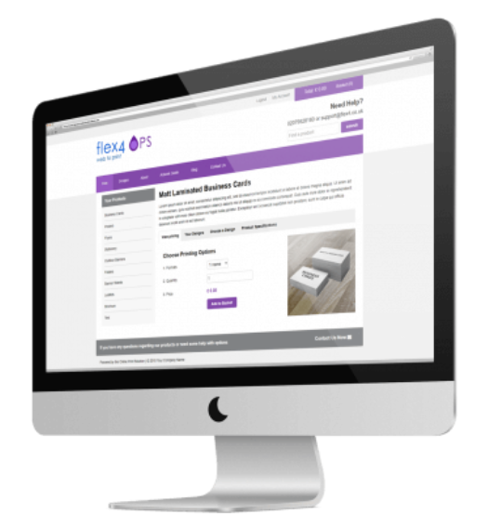
Agenda
What is a Private Branded Storefront?
Printer Benefits
Winning New Clients
Selecting a Supplier
Find Out more …..

Slide 3
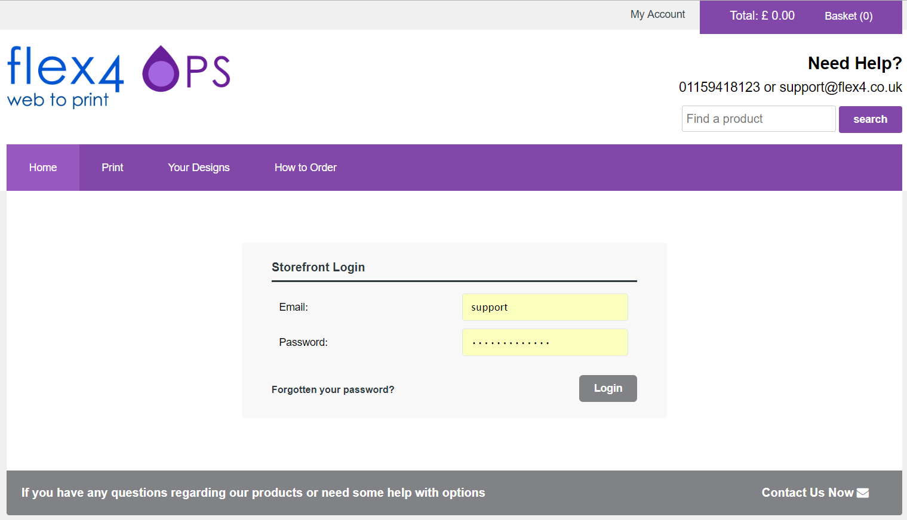
What is a Private Branded Storefront?
Sometimes referred to as:
Web to Print Storefront
Client Storefront
Web Portal
Will usually include:
Private (Login needed)
Branded
Client Specific
Web to Print Templates
Standard Print Call-Offs
Online Ordering
Stock & Budget Control
Approval Workflow

Slide 4
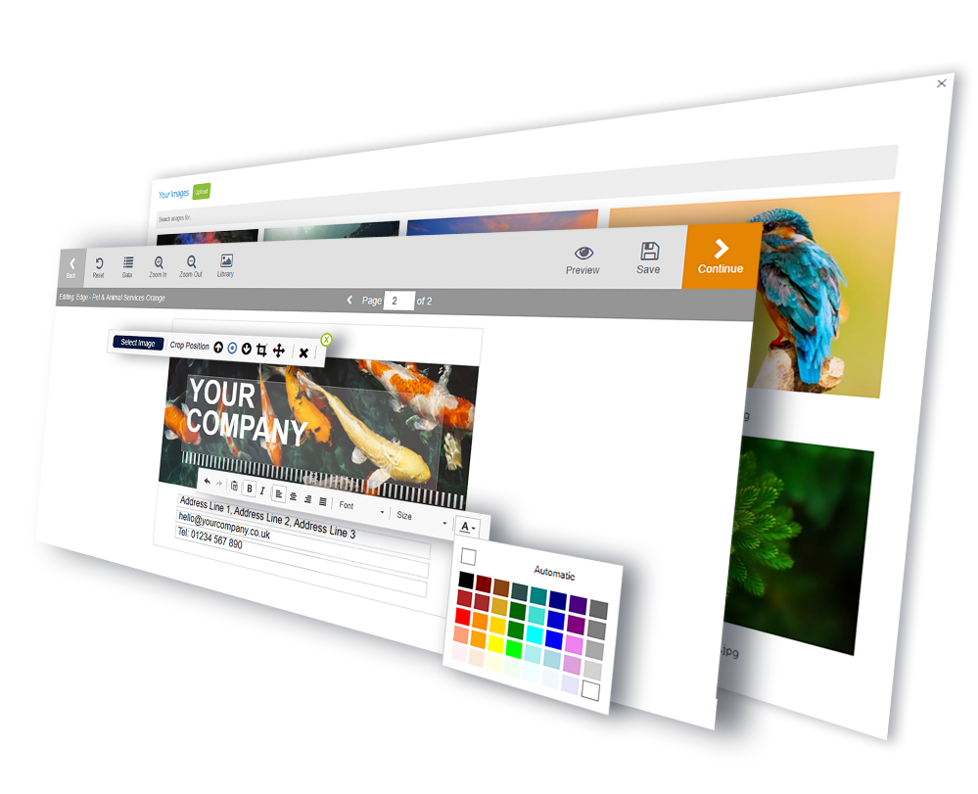
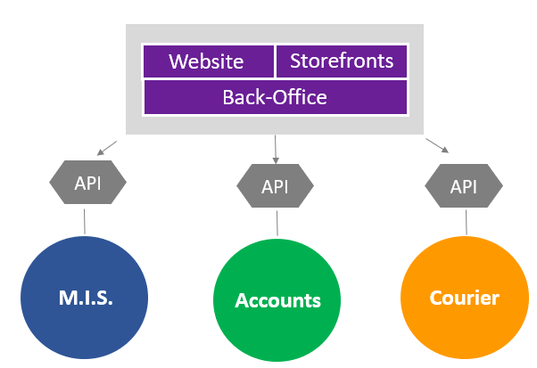
Storefront Benefits
Win new clients
Turn Artwork Into Editable Templates
Easy client re-ordering
Improve customer retention
Efficient enquiry / order management
Improved administration
Reduced Pre-Press Work
Improved cashflow
Integration

Slide 5
Winning New Clients
Key Sales Points:
Brand Protection
Reduced Print Procurement Costs
Efficient Print Procurement Processes
Budgetary Control
Improved Staff Administration in Multiple Location
More Effective Marketing Activity
Reduced Print Stockholding

Slide 6
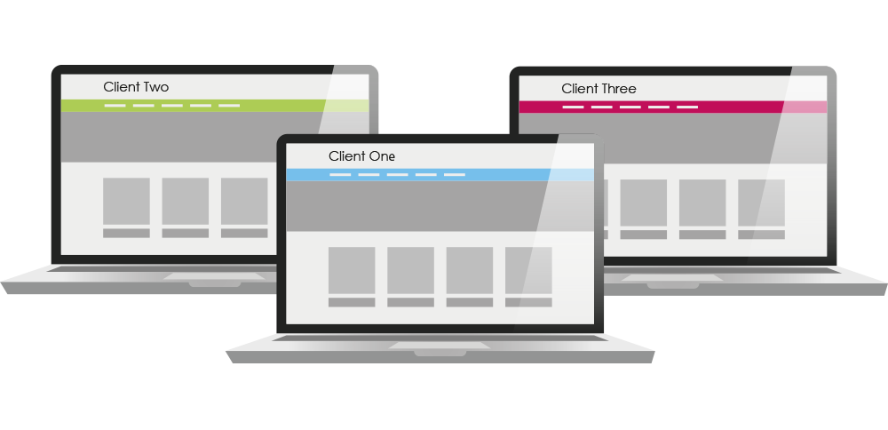
Selecting a Supplier
Web to Print Experience
Upgrade Path
Bespoke Development & Integration
Sales / Demo Support
Training & User Documentation
Helpdesk Support
Technology Platform Used
Single Solution – B2C & B2B
Flexible Template Editing
Depth of Functionality

Slide 7
Find Out More
Resources:
Slides
How to Sell Storefronts Guide (Coming Soon)
Visit www.onlineprintsolution.co.uk/resources
Enter your business card in our free draw for a chance to win either:
A Free Print eCommerce Website
or
W2P Private Storefront
or A free 12 month local search marketing campaign All entrants receive a free SEO review
Come and see us on Stand P130

Slide 8
Questions

