Slide 1
How to Grow Your Business By Selling Print Online
Presented by: David Whiteley
Stand P130

Slide 2
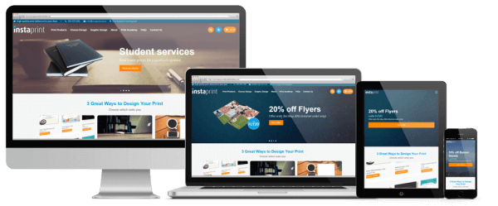
Agenda
The Opportunity
Print eCommerce
Web to Print eCommerce
Back-Office System
A Case Study

Slide 3
The Opportunity
Increase Turnover
– more orders and enquiries
Reduce Admin Costs
– more efficient admin processes
= Improved Profitability
Improve Customer Service
– 24 hour service with easy online ordering

Slide 4
Opportunity Areas:
Print eCommerce
Increase Turnover
Reduce Admin Costs
Improve Customer Service
Product Catalogue
Online Ordering
Quotation System
Sales
Website
Visitors
Sales
W2P Storefronts
Digital Marketing
Website
Visitors
Production
Order Processing
Artwork Upload
Online Proofing

Slide 5
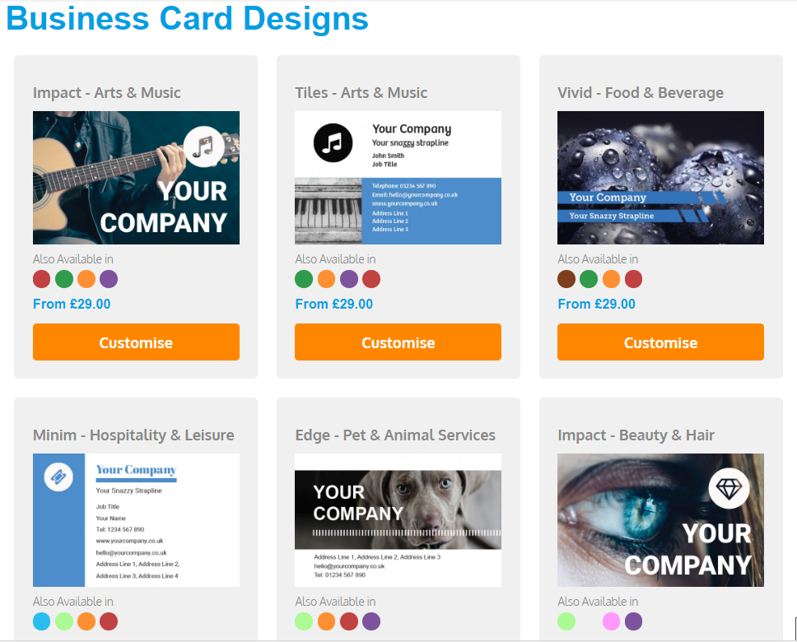
Opportunity Areas:
Web to Print eCommerce
Increase Turnover
Reduce Admin Costs
Improve Customer Service
+
Online Ordering
Templates
Print Ready PDF
Ability to offer 3 design options:
Client Supplies Artwork
Own Design Service
Template Customisation (Web to Print)
Editable Template Gallery

Slide 6
Opportunity Areas:
Back-Office System
Increase Turnover
Reduce Admin Costs
Improve Customer Service
Typical features:
CMS (e.g. Wordpress) for Website Updates
Product Catalogue Maintenance
Template Setup
Order Management
Customer Management
Reporting
3rd Party Software Integration
Website
Storefronts
Back-Office
API
API
API
M.I.S.
Accounts
Courier

Slide 7
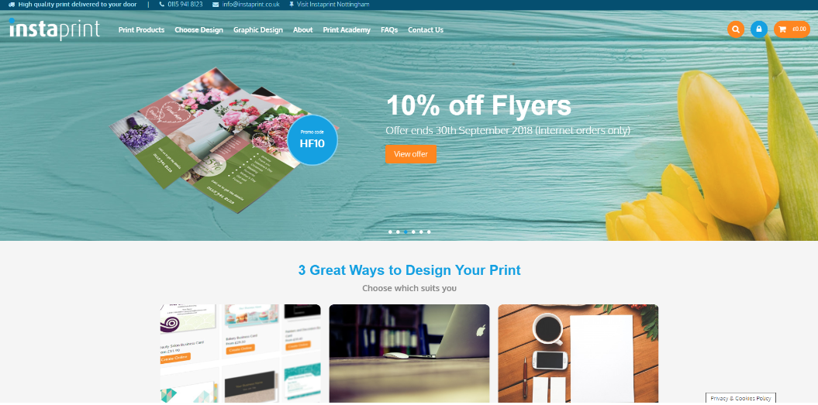
Case Study
Print eCommerce Website 2013
On-going digital marketing
Upgrade to W2P templates 2015
ROI to-date:
Total investment : £36K
Total order revenue : £372K
Total ROI : £336K
Excludes revenue from increased enquiries and savings on administration
www.instaprint.co.uk
“The enquiry levels went through the roof. We have generated some really nice orders.”
Peter Gauntley – Previous Owner

Slide 8
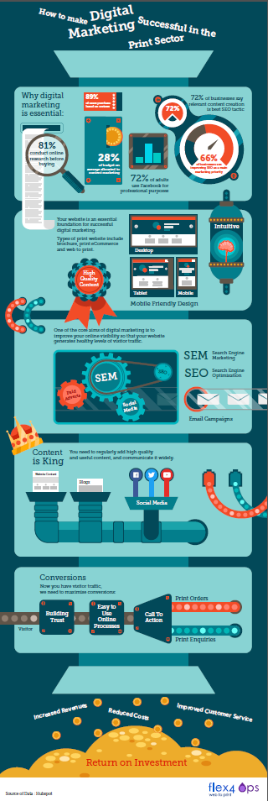
Find Out More
Resources:
Slides
Full Instaprint Case Study
Digital Marketing Infographic
Enter your business card in our free draw for a chance to win either:
A Free Print eCommerce Website
or
W2P Private Storefront
or A free 12 month local search marketing campaign All entrants receive a free SEO review
Visit www.onlineprintsolution.co.uk/resources
Come and see us on Stand P130

Slide 9
Questions?

Slide 10
Opportunity Areas:
Digital Marketing
Increase Turnover
Reduce Admin Costs
Improve Customer Service
SOCIAL MEDIA
DIGITAL
MARKETING
SEO
CONTENT MARKETING
EMAIL MARKETING
SEM
VIDEO PRODUCTION
Digital Marketing Infographic

