Slide 1
If you build it, will they come?
Presented by: David Whiteley
Stand P130

Slide 2
The Answer is – not necessarily!

Slide 3
Local Search Marketing for Printers

Slide 4
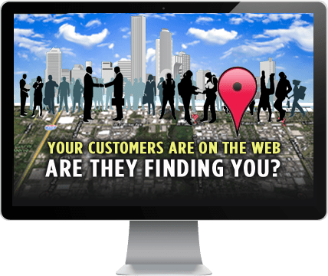
Agenda
Digital Marketing - Overview
Importance of Local Search
Local Search Initiatives
Case Study
How to Achieve Success
Questions

Slide 5
Digital Marketing - Overview
SOCIAL MEDIA
DIGITAL
MARKETING
SEO
CONTENT MARKETING
EMAIL MARKETING
SEM
VIDEO PRODUCTION

Slide 6
Importance of Local Search
1. Local customers are turning to the internet to find local businesses - on desktop AND mobile devices
96% of PC owners conduct local searches
46% of all Google searches are local
64% of local customers use search engines and directories as the main way to find a local business
50% of local mobile searchers look for local business information
78% of local mobile searches result in an offline purchase
Sources : searchengineland.com and business2community.com

Slide 7
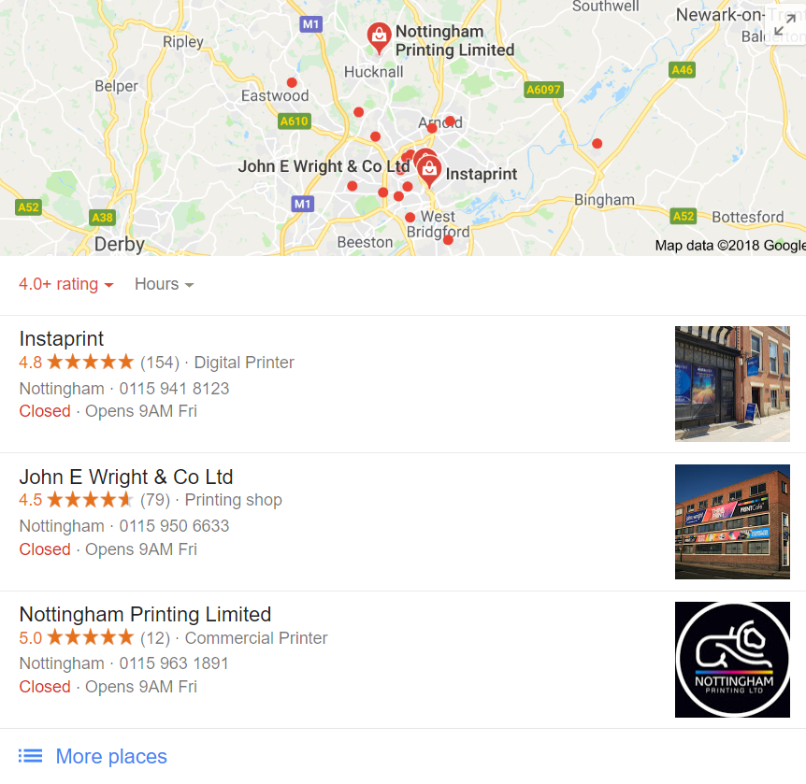
Importance of Local Search
2. Local search marketing is highly targeted and timely
Top 2 reasons for local searches are to find a business or a product / service
People tend to search when they are ready to buy
Fewer competitors – easier to achieve good rankings
3. Claim your Google My Business and Bing Places listing
FREE local listings provided by Google and Bing
4. Only 20% of adults get news from print newspapers
More and more people now use the internet for local news and information on local businesses
6. Over 85% of local consumers trust online business reviews
Word of mouth still an important local marketing factor
Build your local brand through online reviews

Slide 8
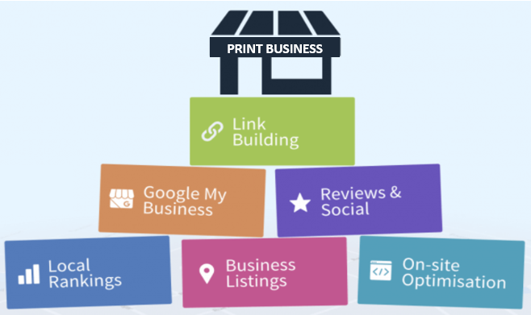
Local Search Marketing – initiatives
Build quality backlinks
Claim your listing
Build reviews
Website ‘localisation’
Local search visibility
Citation building

Slide 9
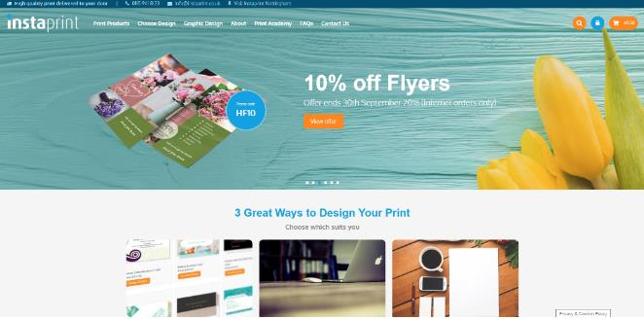
Local Search Marketing - Case Study
Print eCommerce Website 2013
On-going digital marketing
Upgrade to W2P templates 2015
ROI to-date:
Total investment : £36K
Total order revenue : £372K
Total ROI : £336K
Excludes revenue from increased enquiries and savings on administration
www.instaprint.co.uk
“The enquiry levels went through the roof. We have generated some really nice orders.”
Peter Gauntley – Previous Owner

Slide 10
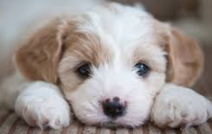
Achieving Business Growth
Visibility
Visitors
Not Just for Xmas!
Conversions
= Enquiries or Orders
An on-going process!

Slide 11
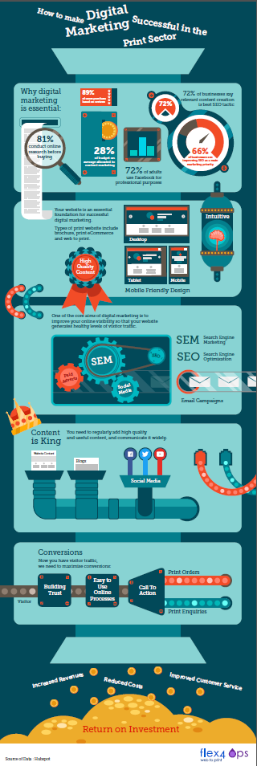
Find Out More
Resources:
Slides
Full Instaprint Case Study
Digital Marketing Infographic
Enter your business card in our free draw for a chance to win either:
A Free Print eCommerce Website
or
W2P Private Storefront
or A free 12 month local search marketing campaign All entrants receive a free SEO review
Visit www.onlineprintsolution.co.uk/resources
Come and see us on Stand P130

Slide 12
Questions?

